Slide 2

Winter Paralympics
The Winter Paralympics take place every four years.
In 2022, the Winter Paralympics will take place in the city of Beijing, China.
This is the Chinese flag.
They will begin on 4th March and last for ten days.

Slide 3
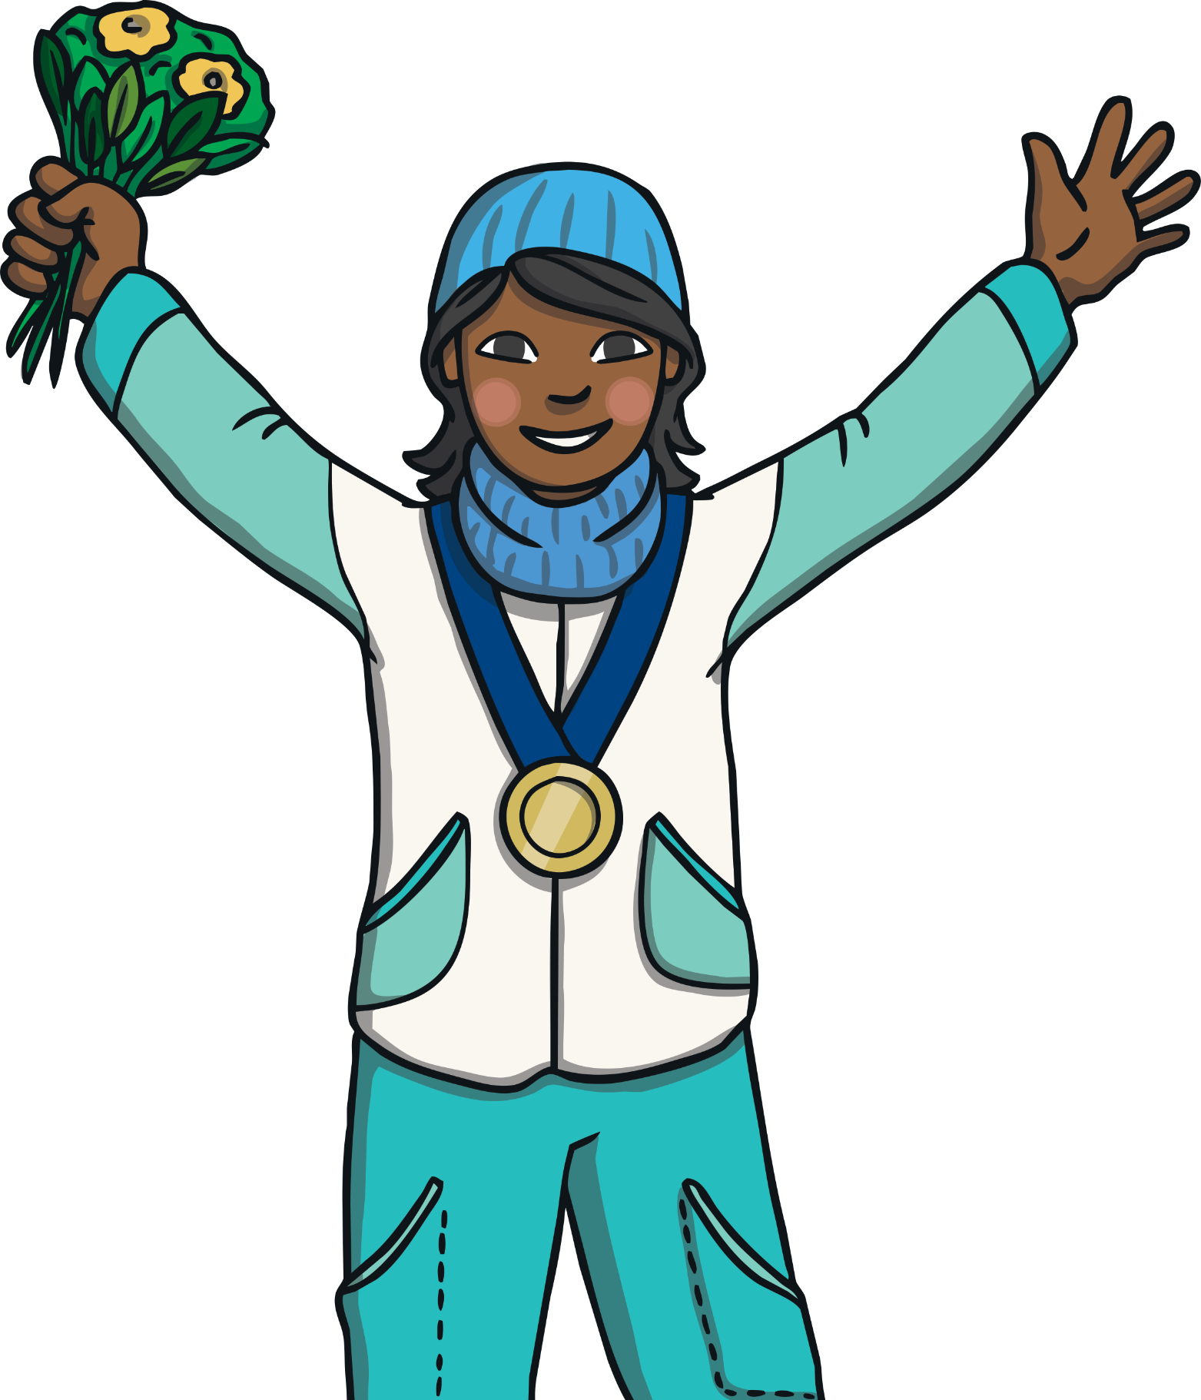
All around the World
There are hundreds of athletes from all around the world
taking part in the Winter Paralympics.
There are 76 gold medals to be won.

Slide 4
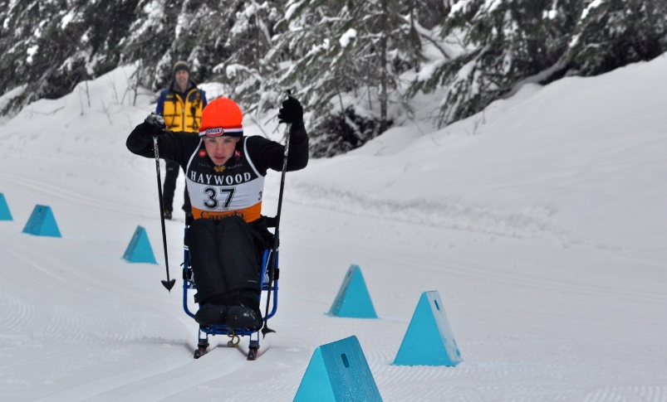
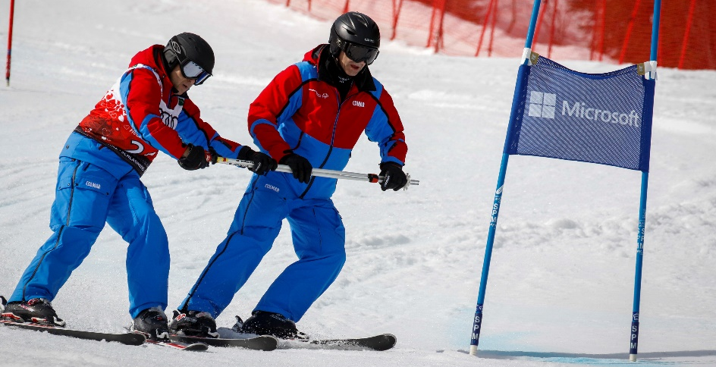
Paralympic Athletes
Athletes who take part in the Winter Paralympics have a physical disability. That means some athletes will need to use different equipment.
Some might need support from others so that they can take part.
An athlete who usually uses a wheelchair will need to sit down to ski. This is called a sit ski.
A skier who cannot see very well will have a guide with them. The guide will help them to know where they are going.
Photo courtesy of tirebitermedia , sowwg2017 (@flickr.com) - granted under creative commons licence – attribution

Slide 5
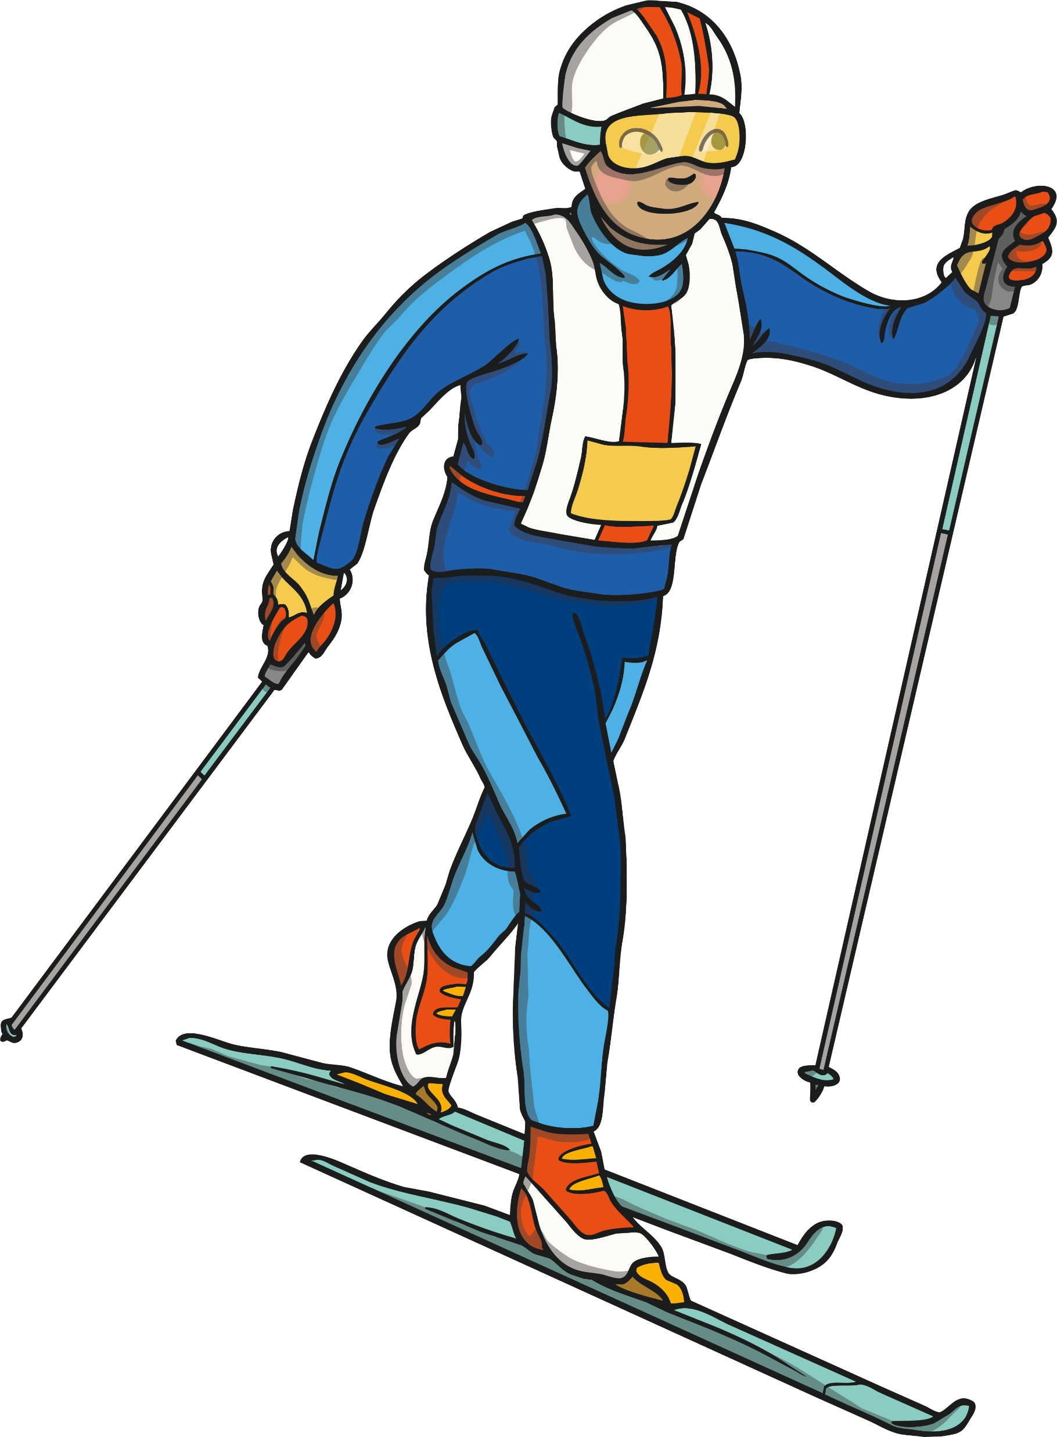
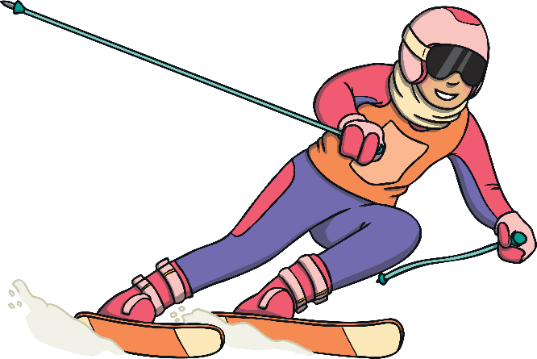

Winter Sports
There are six sports in the Winter Paralympics.
Click each event name.
alpine skiing
ice sledge hockey
biathlon
snowboarding
cross country skiing
wheelchair curling
Think about it
What sort of weather does there need to be for the Winter Paralympics??
Click the thought bubble for an interesting question!

Slide 6

Mascot for 2022
The 2022 Winter Paralympics mascot is Shuey Rhon Rhon.
It is based on a Chinese lantern.
Chinese lanterns are a symbol of success and celebration.
Click here to meet Shuey Rhon Rhon!

Slide 7

Reflection
Think about it
Mascots are often based on animals. What animal do you think would make a good mascot for the Winter Paralympics?
Click the thought bubble for an interesting question!

