Slide 2
Aim
To identify the role of the Universal Declaration of Human Rights.
Success Criteria
I can identify some human rights.
I can identify the importance of the Universal Declaration of Human Rights.

Slide 3
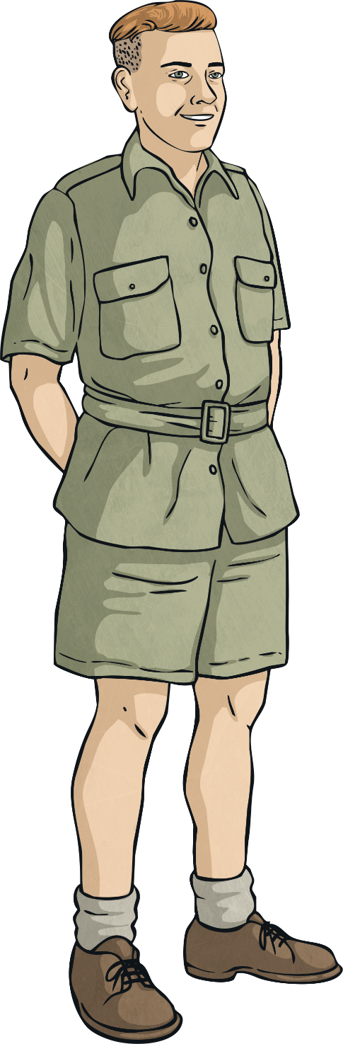
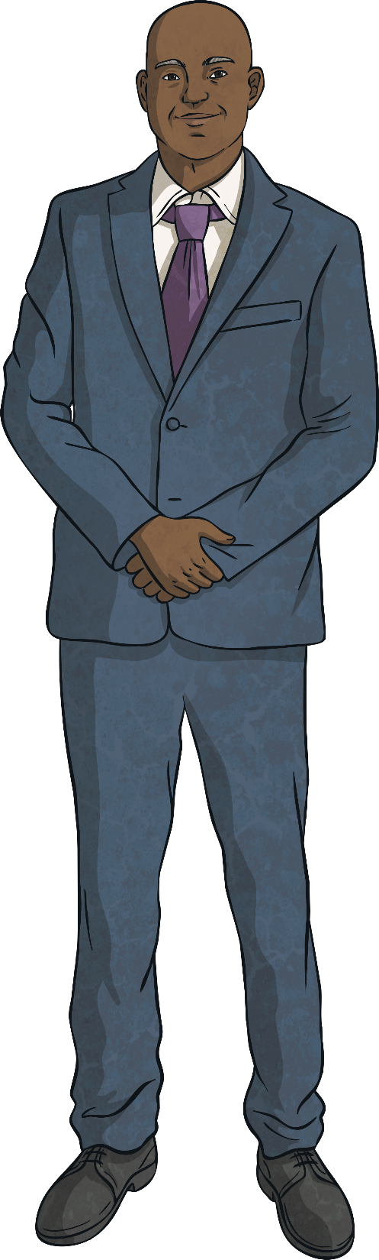
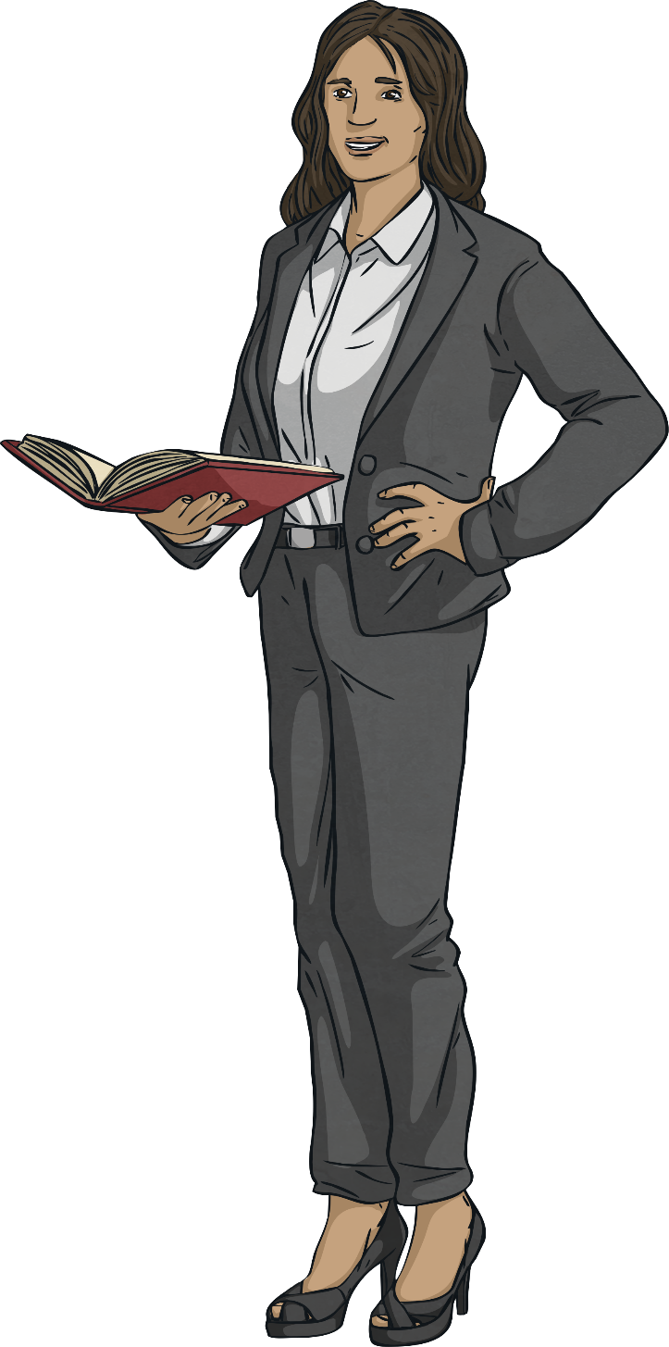
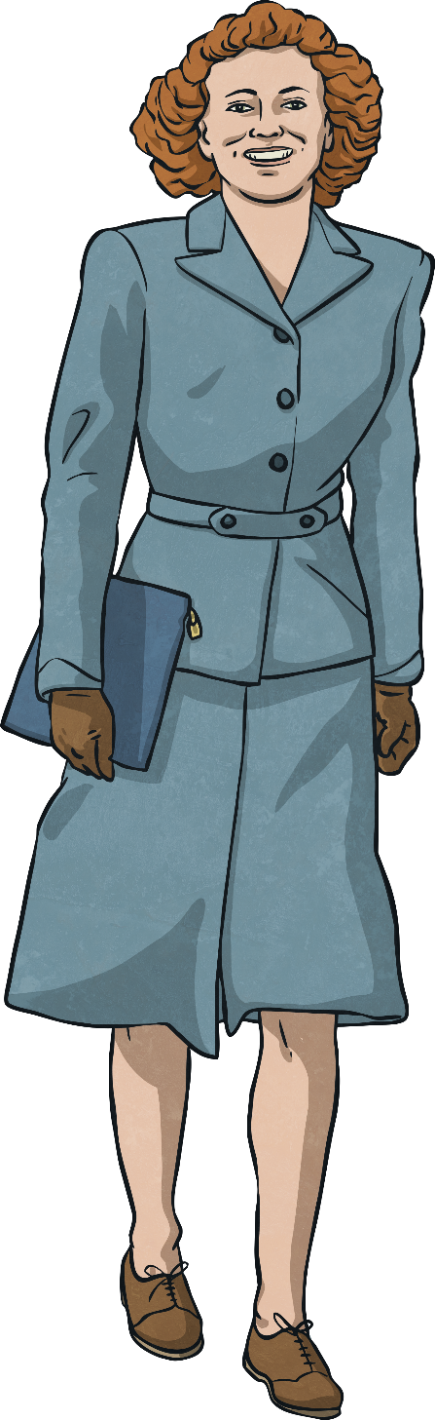

What Are Human Rights?
Human rights are rights that belong to every individual, regardless of race, sex, religion, nationality or ethnicity, etc. Following the Second World War, the need to prevent such atrocities happening again in the future was evident and as a result, the UN (United Nations) drafted the Universal Declaration of Human Rights as a standard for all nations to adhere to in order to protect the rights of every individual across the world.

Slide 4
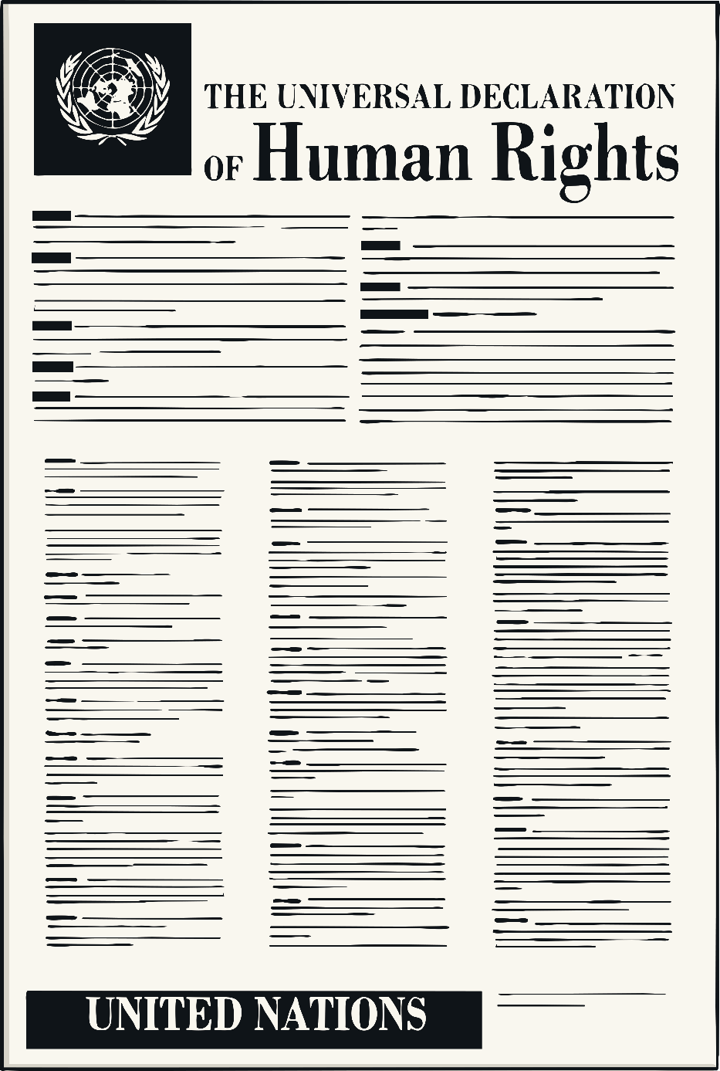
What Is the Universal Declaration of Human Rights?
The Universal Declaration of Human Rights is a document which states a list of rules and rights which every person is entitled to.
It was written by people from all around the world, a group of people known as the UN (United Nations).
It has been translated into over 500 languages.
It was officially introduced on the 10th December, 1948.
Do you know any human rights?

Slide 5

What Is the UN (United Nations)?
The United Nations is an organisation made up of representatives from different countries who work together to prevent and stop wars.
They also work on human rights, ensuring that people all over the world have continuous improved conditions.
There are currently 193 countries within the United Nations.
The United Nations compiled the Declaration of Human Rights.

Slide 6
Human Rights
With the person beside you discuss the following:
The right to free speech.
The right to a fair trial.
The right to an education.
Freedom from slavery.
No discrimination.
Freedom of thought, religion and belief.
The right
to life.

Slide 7
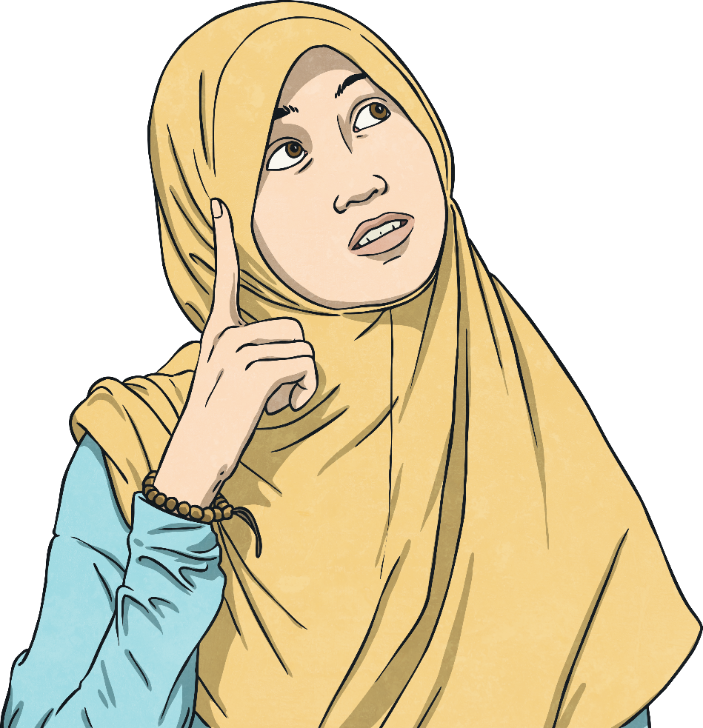
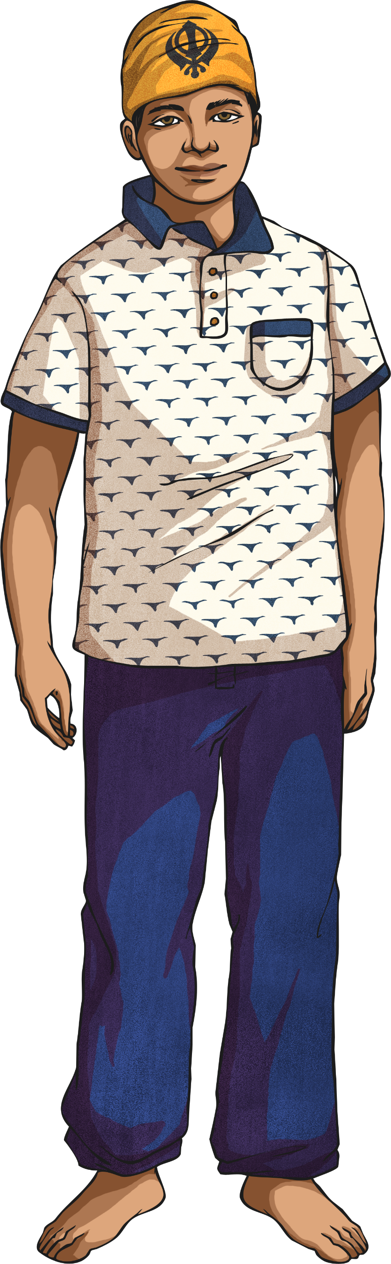
Human Rights Violations
With the person beside you, discuss which human right has been violated in these scenarios.
Fahima is 10 years old. She lives in Sudan. She stays at home every day and helps her mother in the house.
Gurinder is 14. As a Sikh, he wears a turban as part of his religious beliefs. His school have informed his parents that his turban is not part of his school uniform and he can no longer wear it to school. He has been told that he can return to school when he is no longer choosing to wear the item.

Slide 8
Aim
To identify the role of the Universal Declaration of Human Rights.
Success Criteria
I can identify some human rights.
I can identify the importance of the Universal Declaration of Human Rights.

