Slide 3
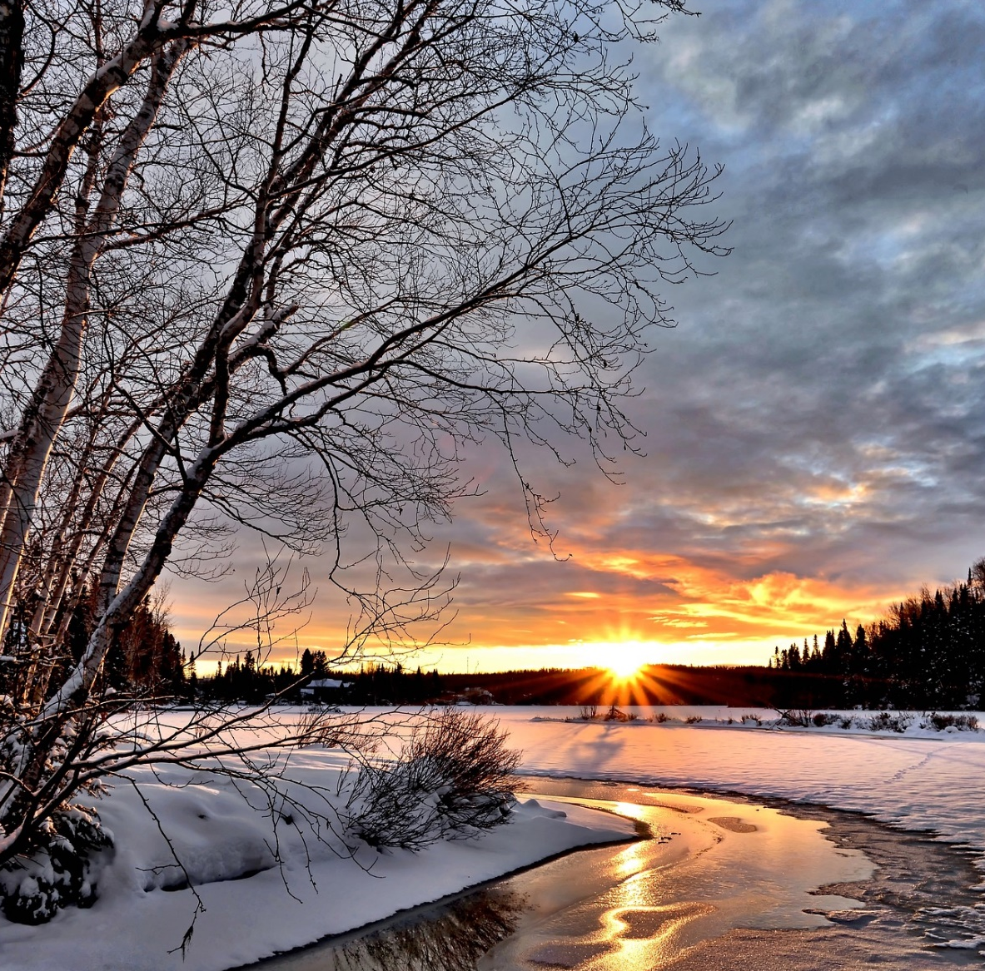
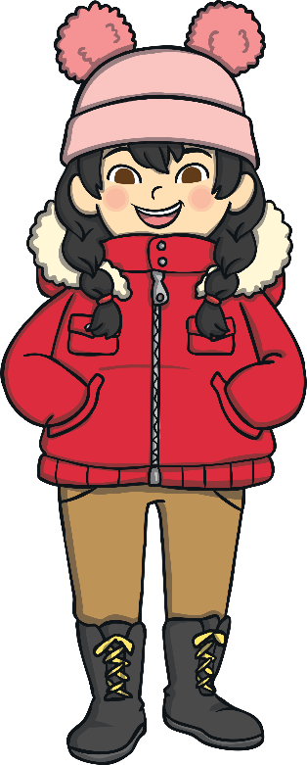
    Wonderful Winter
      What do you know about winter?
      What happens to the weather in winter?
      What do trees look like in winter?
Do you know any facts about winter?

Slide 4
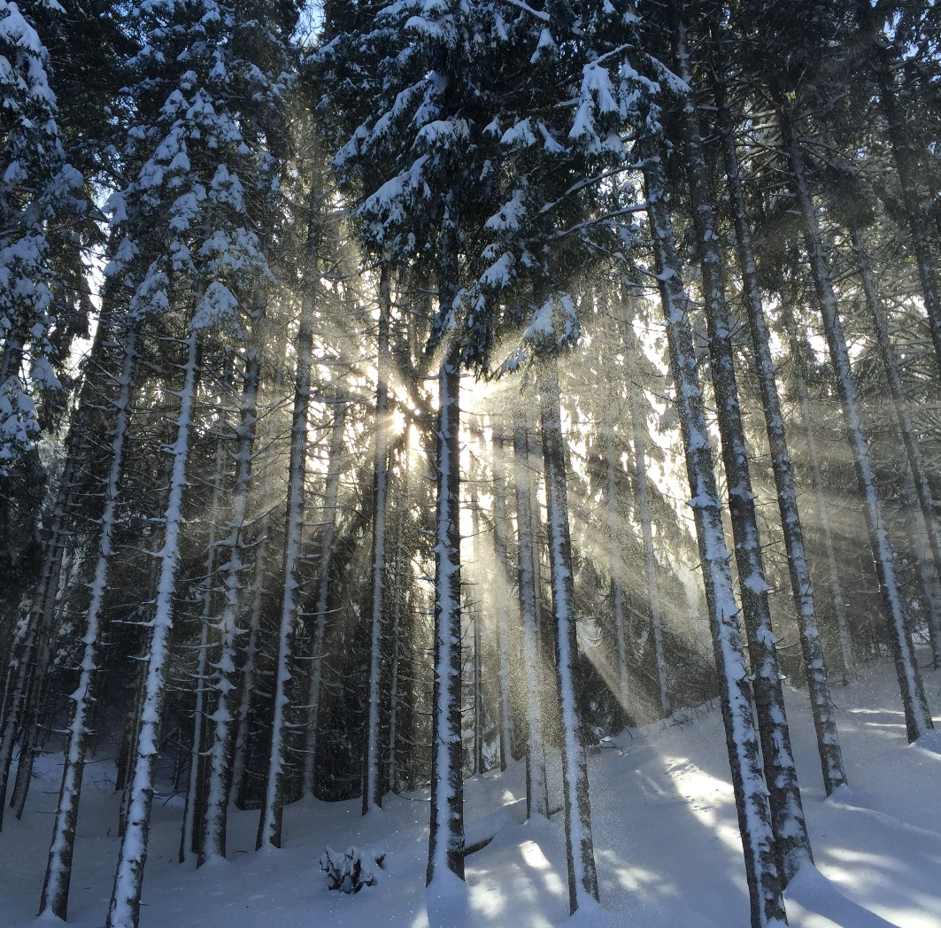
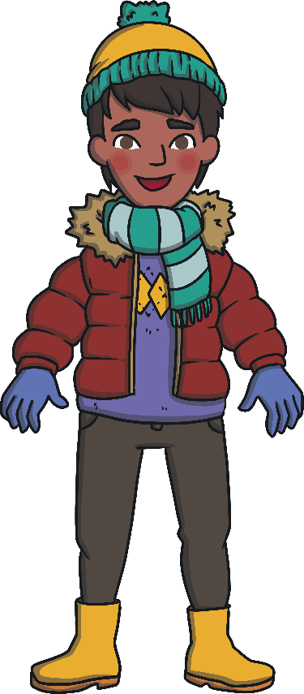
    What is Winter?
Winter is one of the four seasons.
In the United Kingdom, winter takes
place in the months of December, January and February.
Scientists say that winter begins around the 21st
or 22nd December and lasts until the beginning
of March, when it becomes the spring season.
Did You Know…?
The start of winter is marked by the winter solstice. This is the shortest day when there is the least amount of light.

Slide 5
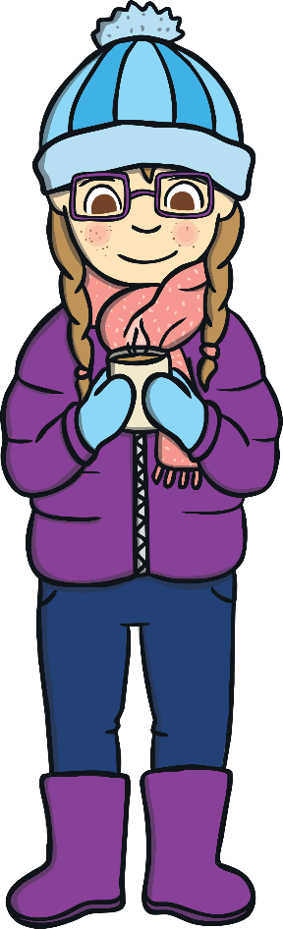
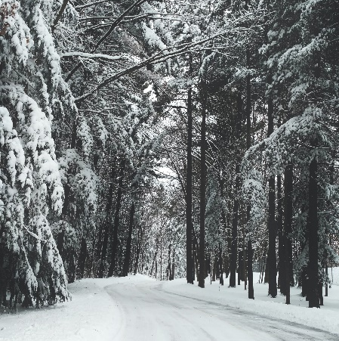
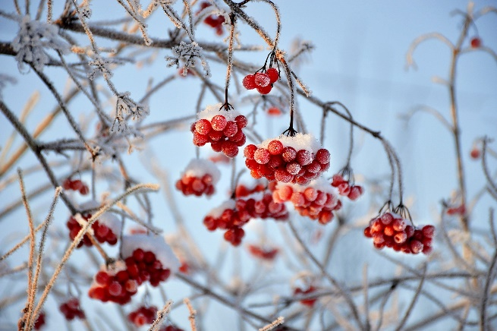
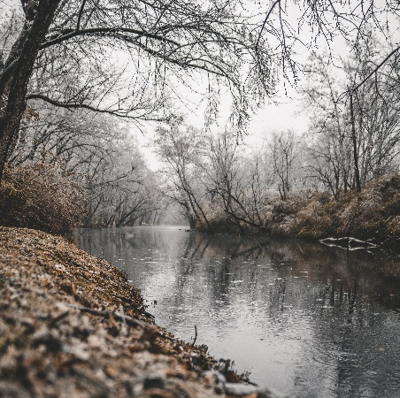
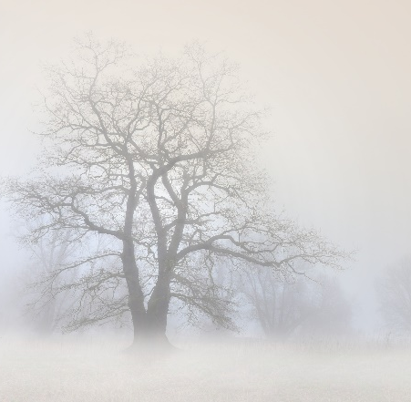
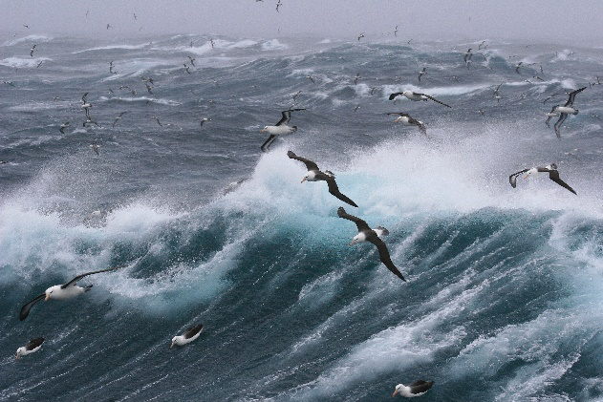
    Weather in Winter
What clothing should we wear in winter?
      The weather changes all the time in winter. It is typically the coldest season.
snowy
frosty
rainy
foggy
windy

Slide 6
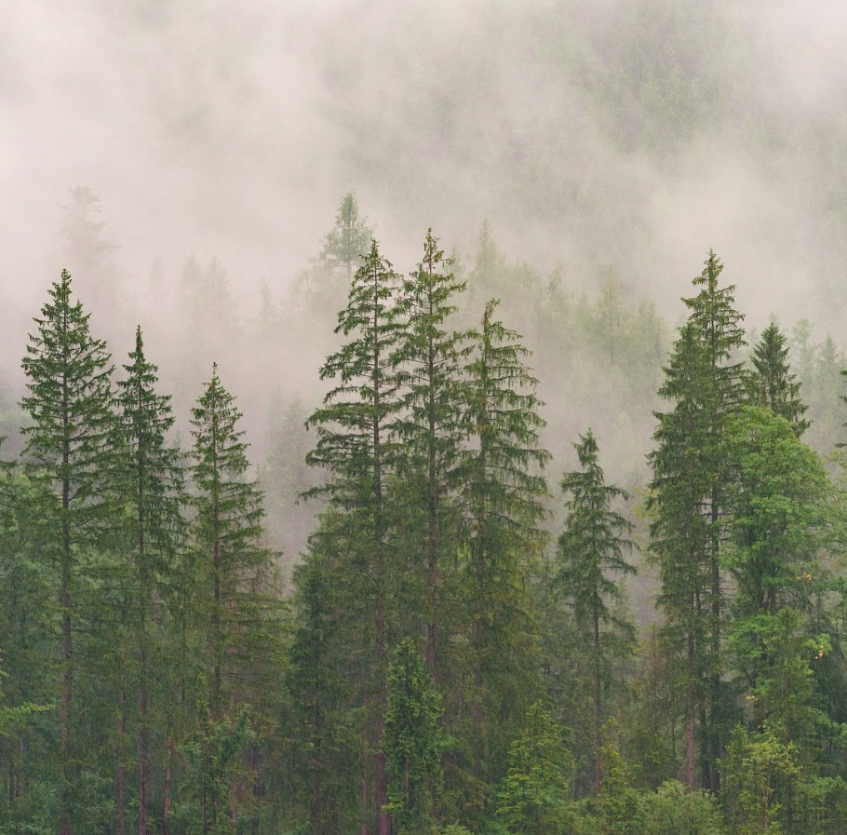
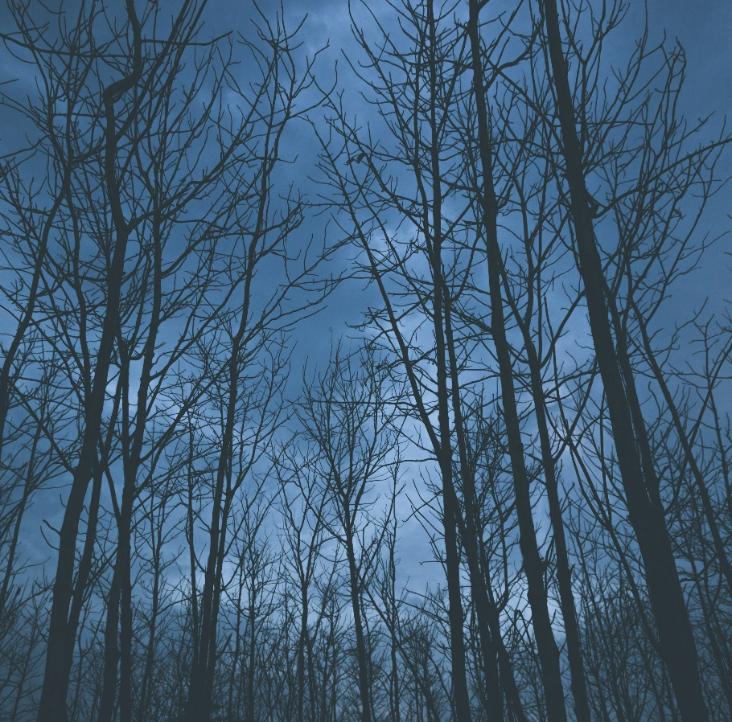
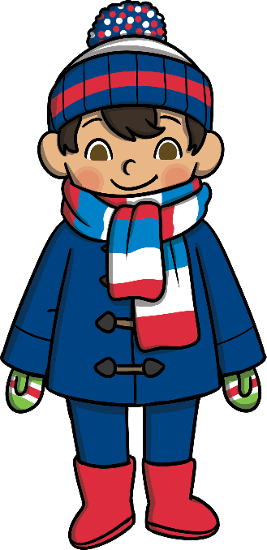
    Trees in Winter
Some trees do not lose their leaves in
winter. The leaves are often called needles
and they stay on the tree all year round.
Other trees begin to lose their leaves in
autumn and will then lose all of
autumn and will then lose all o their leaves during winter.
      This means that some trees are very bare during winter!
Trees that do not lose their leaves are often called ‘evergreens’. This is because they are green all year round.

Slide 7
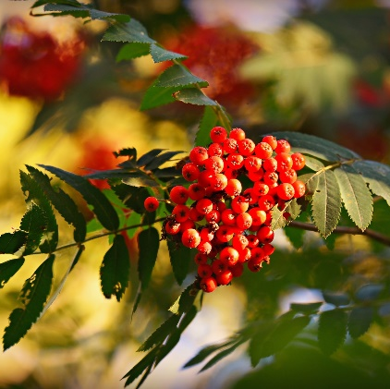
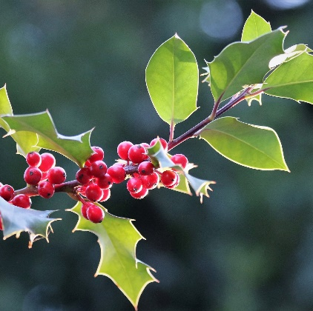
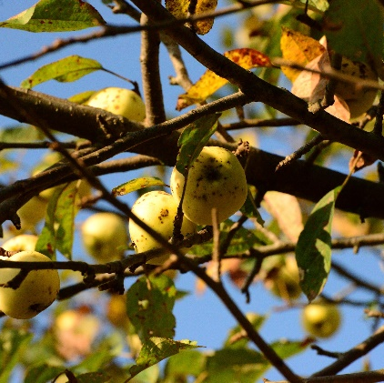
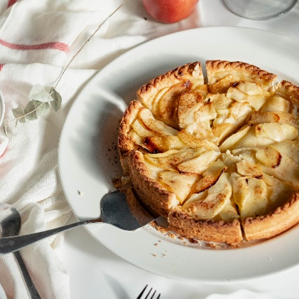
    Bright Berries and Winter Fruits
    Look out for bright red berries on rowan and holly trees during winter.
    Some fruits still grow in winter. A crab apple is a small, sour apple. The best time to pick them is during winter. They can be used to make apple pies, crumbles or jellies.
Why might bare trees in winter make it easier to spot birds?

Slide 8
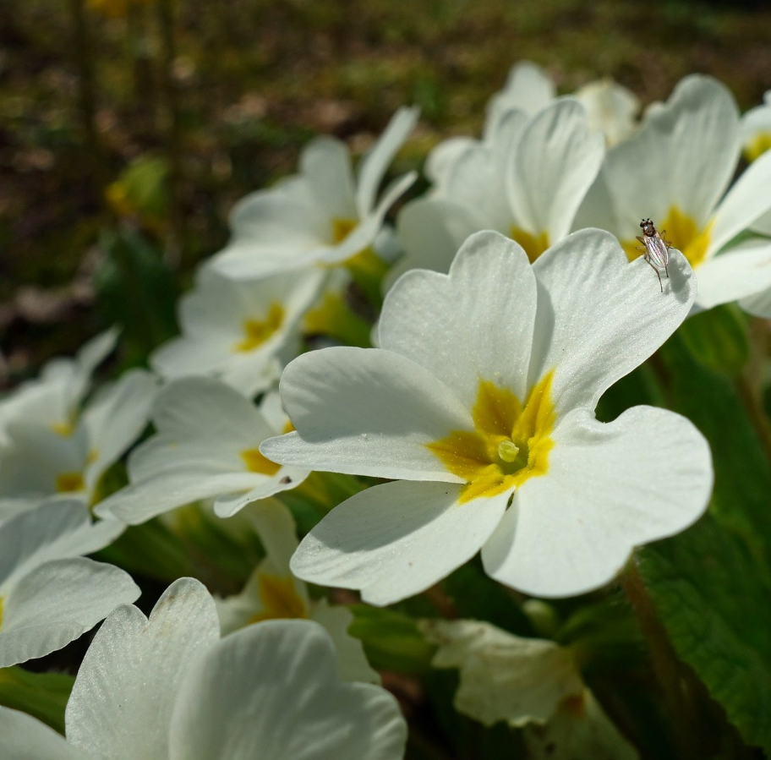
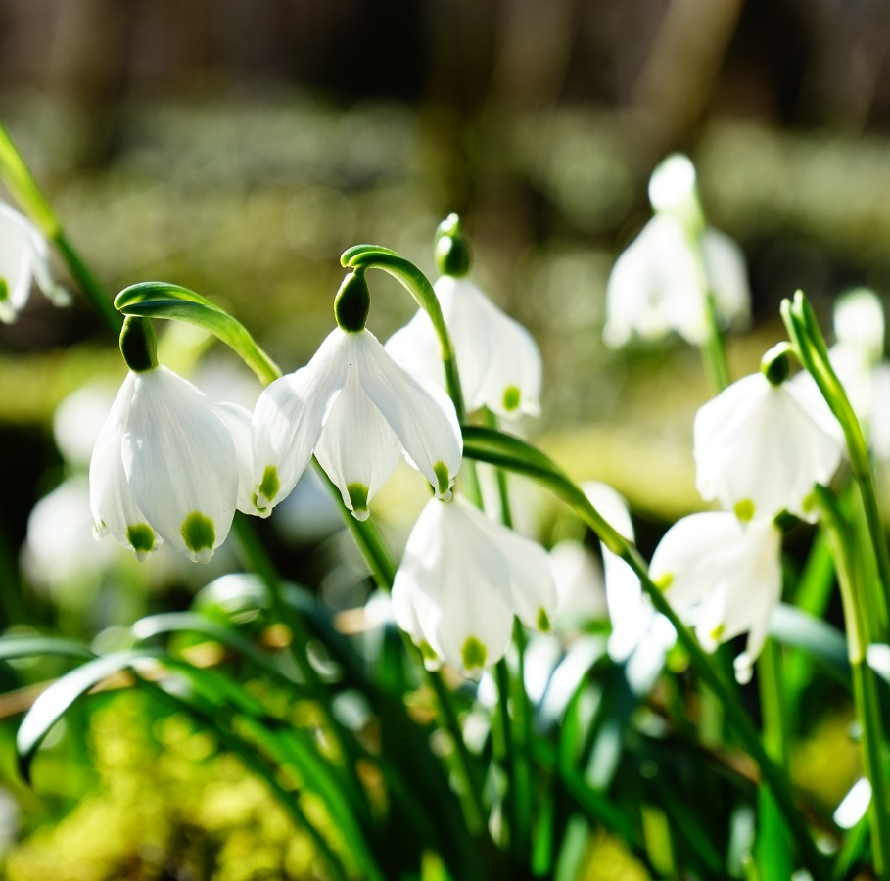

    Winter Flowers
Primroses and snowdrops are two flowers
that you will see in hedgerows and forests
in the winter months.
Primroses are visited by insects,
such as butterflies and bees who like
to drink their delicious nectar.
autumn and will then lose all of
autumn and will then lose all o their leaves during winter.
Have you ever seen any of these flowers on a winter walk?

Slide 9
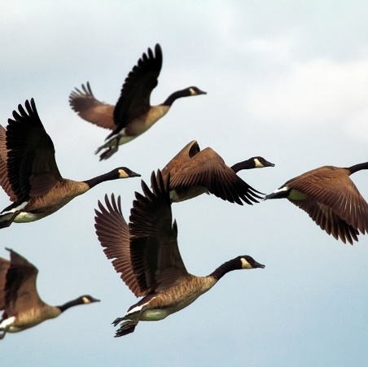
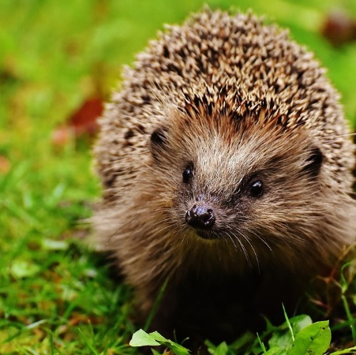
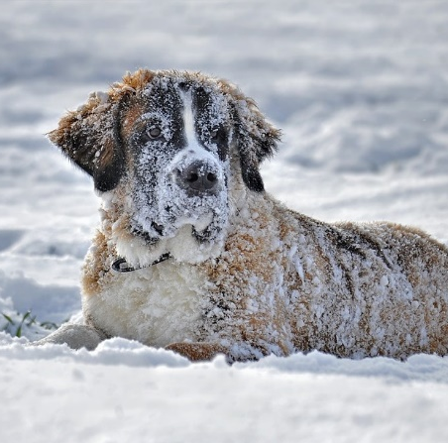

    Animals in Winter
In winter in the UK, it is too cold for many birds so they travel to warmer countries. This is called migration.
The birds then return in spring when
the weather is warmer again.
Some animals, such as hedgehogs and bats sleep through the winter and wake up once it’s warm again. This is called hibernation.
Cats and dogs grow extra fur so they
can stay warm in the winter months.
What do you think it is like for the animals that fly to another country?

Slide 10
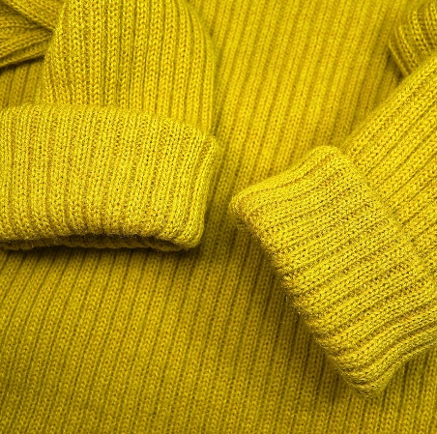
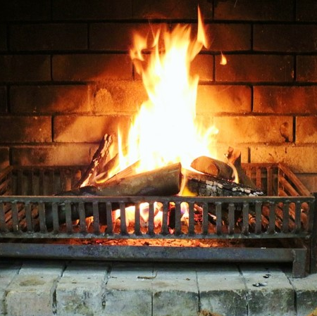
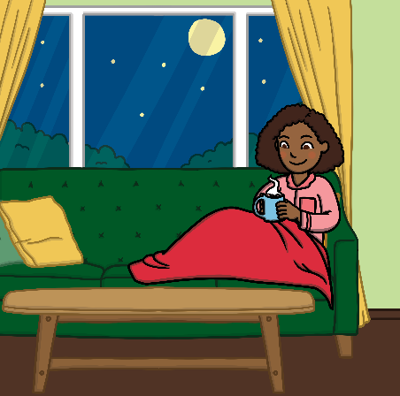
    Keeping Warm in Winter
      The weather can get very cold in winter. Here are some ways of keeping warm.
Wear thick clothes and extra layers.
Light a fire, use a hot water bottle or switch on your heating to keep your house nice and warm.
Eat hot meals, such as stews or porridge and drink hot drinks,
such as hot chocolate.
Can you think of anything else you might do to stay warm in winter?

Slide 11
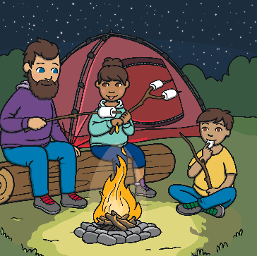
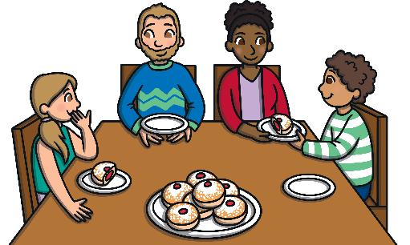
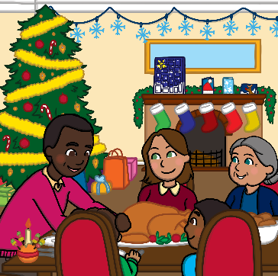
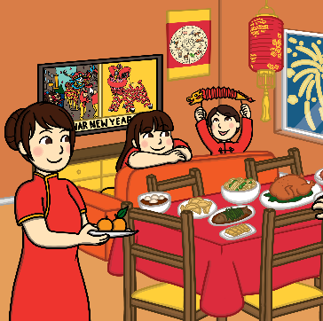
    Celebrations in Winter
Many people for centuries have celebrated the winter solstice, which celebrates the return of the sun.
  Hanukkah is a Jewish festival that lasts
  eight days and usually falls in December.
Christmas is celebrated by Christians around the world in December. Christmas Day is believed to be the day that
Jesus was born and many people give each other gifts.
  Chinese and Lunar New Year marks the start of the lunar calendar and is celebrated on a different day each year in January or February.

Slide 12
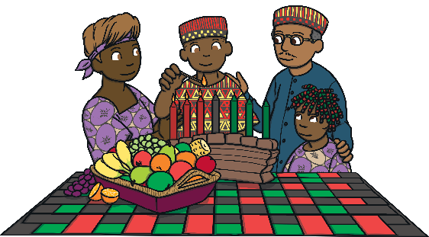

    Celebrations in Winter
On the 31st December, New Year’s Eve is celebrated. Many people watch firework displays and set New Year’s resolutions.
  Kwanzaa is based on an ancient African harvest festival and means ‘First Fruits’. It is celebrated from December 26th to January 1st by many African Americans.
Do you take part in any of these celebrations in winter time?

Slide 13

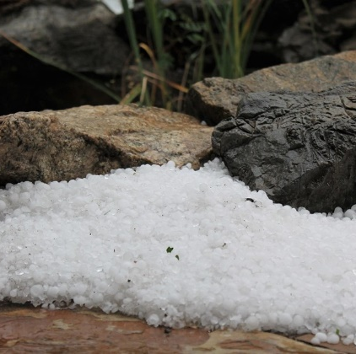
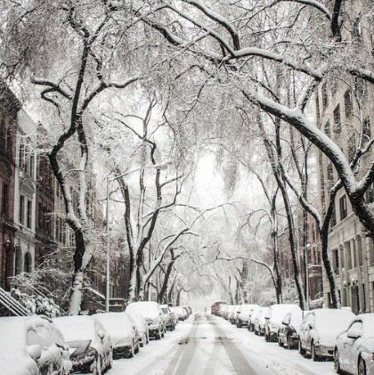
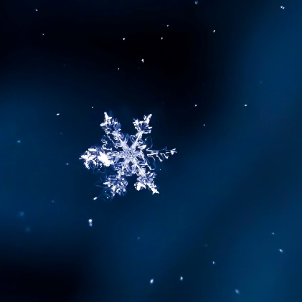
    Fun Facts
    The word winter comes from an old German word which means ‘wet’ or ‘water’.
    Although it doesn’t officially become winter until later in December, meteorologists (people who observe the weather) record the first day of winter from the 1st December.
    Snowflakes have six sides and are made from tiny frozen crystals.
Can you tell a friend something you have learnt about winter?

